Slide 1

Decimation Of Hibernia
A text-Based Adventure game in apocalyptic Ireland
Notes:
New and upcoming
Introduce the game, Name the title and read off the tagline. Suggest its heavily focused on story

Slide 2

Key Creatives
Cian Farrell – Lead Programmer
Corey Shanahan – Lead Designer
From the creators of Tilevania and The Secret Library
Notes:
Introduce Cian, lead programmer. Introduce Corey, Lead designer
Mention our previous games Tilevania and Secret Library

Slide 3

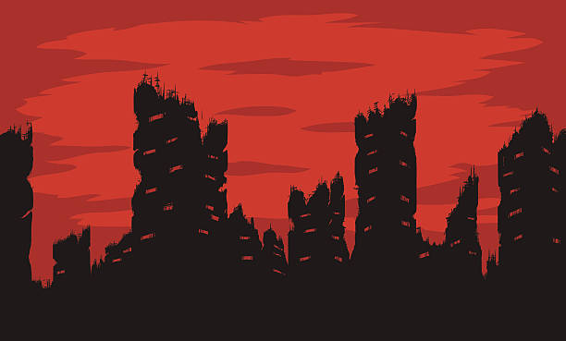
What's it about?
Text based
Heavily focused on story
Set in an Ireland with a decimated population
Post-apocalyptic adventure
Work with a distant friend to unite with him
Ultimately traverse the city and escape to Dublin

Slide 4
Why is this a good game?
Unique Story – Post apocalyptic Ireland is a unique setting
Intriguing Narrative that leads you around the city to eventually escape
Easy to Play – Playable In Browser
Cheap – Only €5

Slide 5
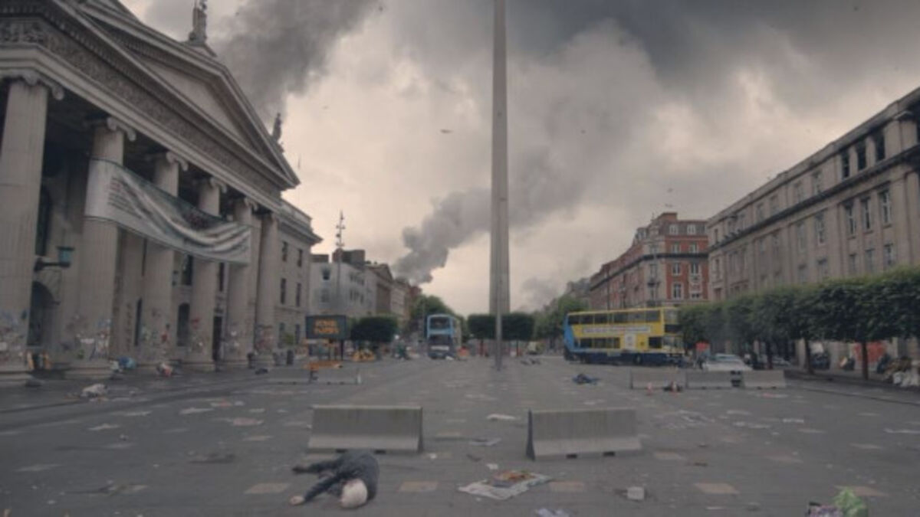
Specific Features
Gameplay – You pick from 4 dialog options.
Storyline – The main character is trying to make it to the last safe city in Ireland, Dublin.

Slide 6
Main characters
Sophie O'Connor (Your Character)
Young woman in her early 20s.
Scavenger
John Power (Man on the radio)
Middle aged man in his early 50s
Soldier who was a part of the Communications and Information Services (CIS) Corp

Slide 7
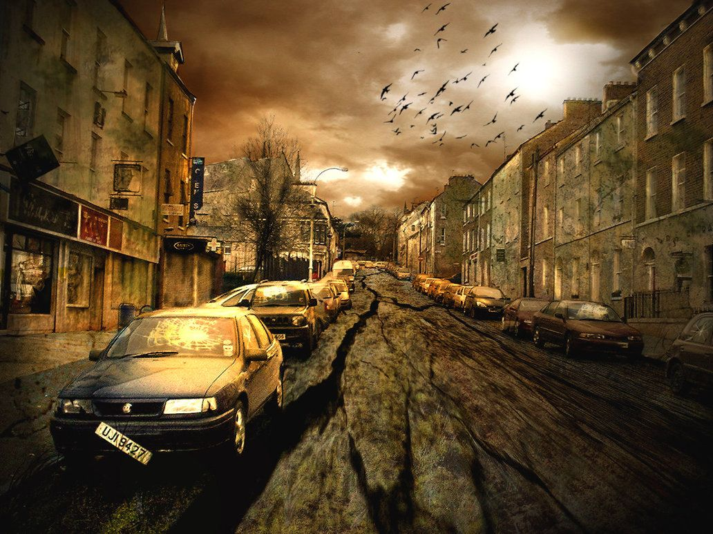
Summary of key facts
Platform – PC and browser (using Inky)
Genre – Adventure
Expected Release date - Jan 14th 2022
Cost – One Off payment of €5
No. Of Players – Single Player
Game Length – 1Hr - 1.5Hrs

Slide 8

Thank you for listening
Any questions?
Notes:
Mention that they should invest in the game

